Slide 1
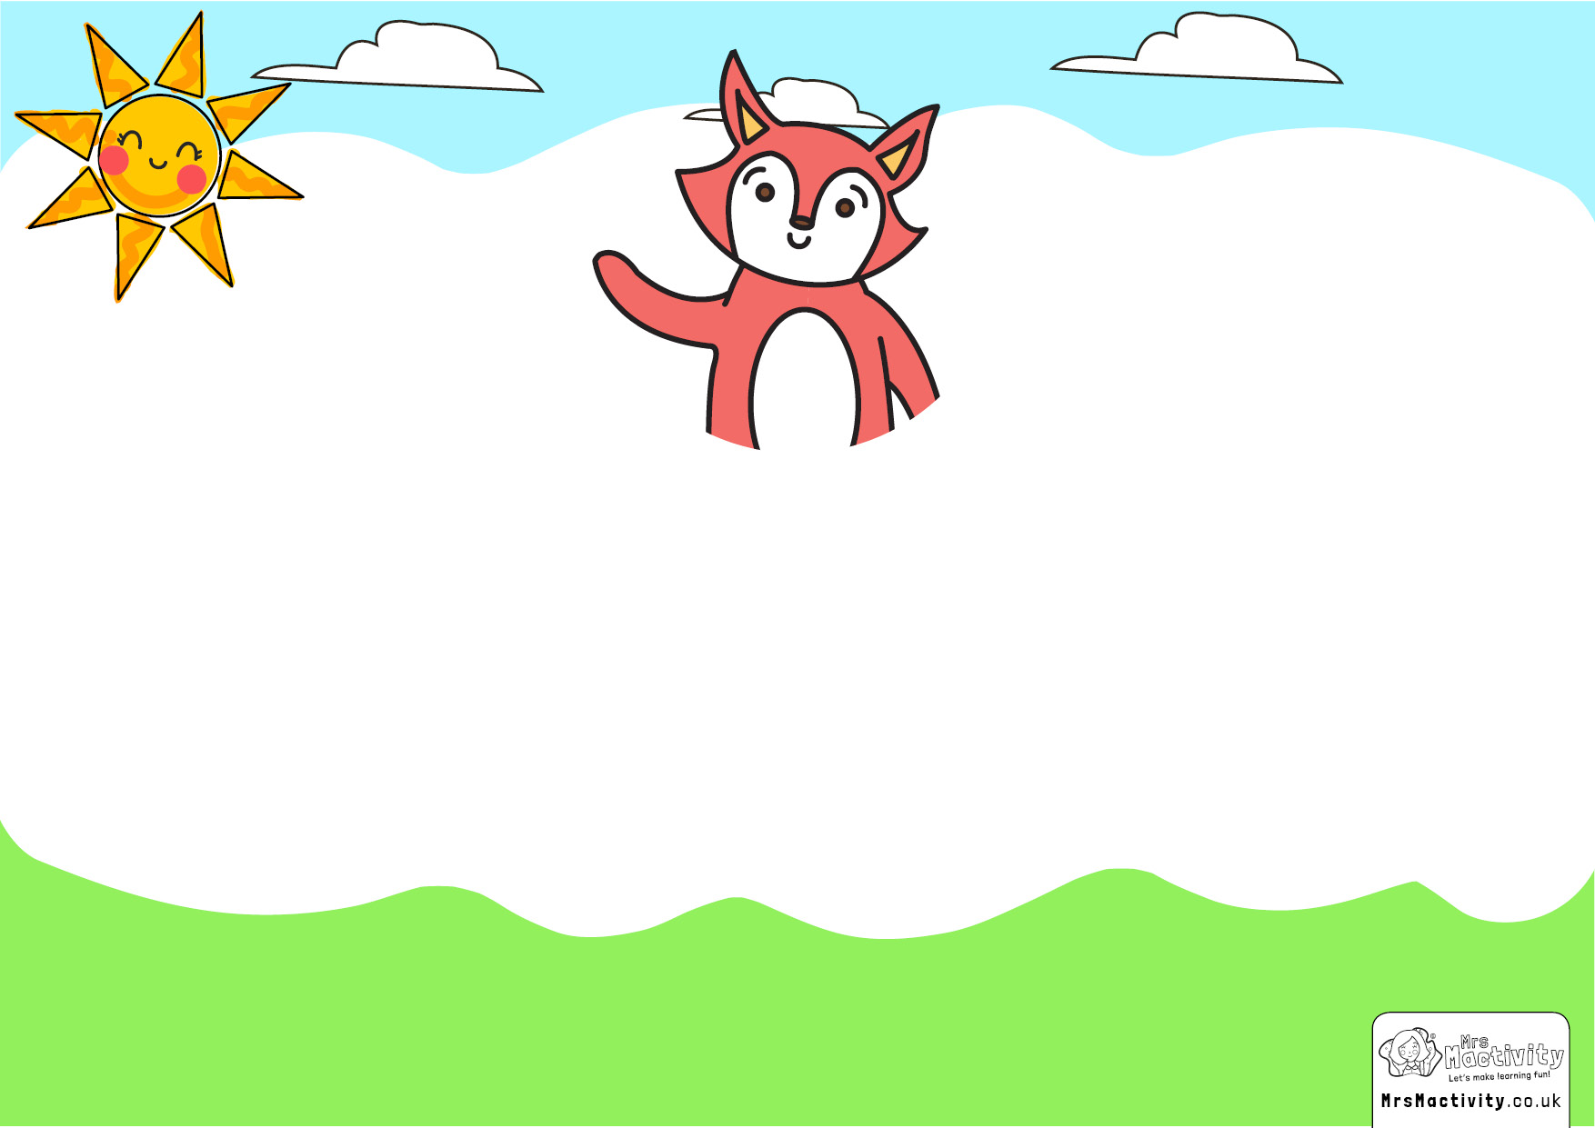
^{I’m starting Year} ^{1!}

Slide 2
^{Welcome to your new} ^{class.}
^{Miss} ^{Walsh is your new teacher.}
Miss Redmond will also be here to help you.

Slide 3
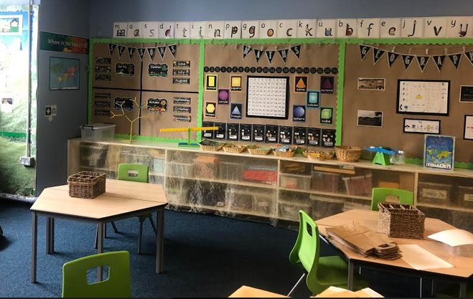
This is what your new class looks like.

Slide 4
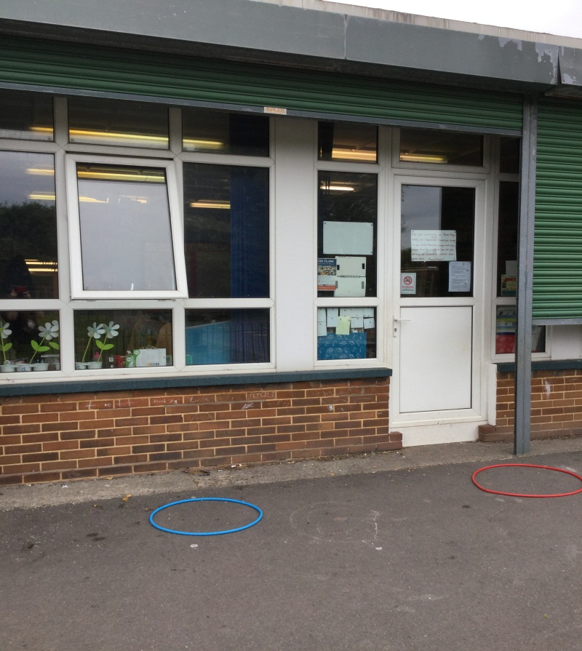
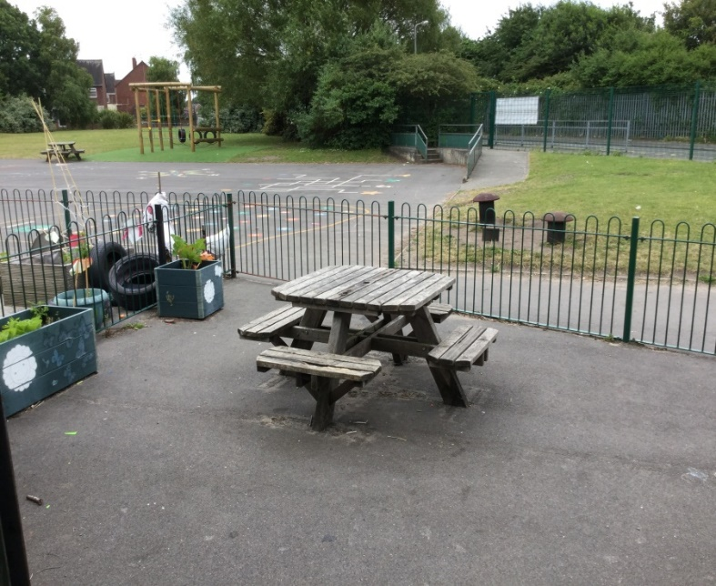
This is your new classroom door and outside area looks like.

Slide 5
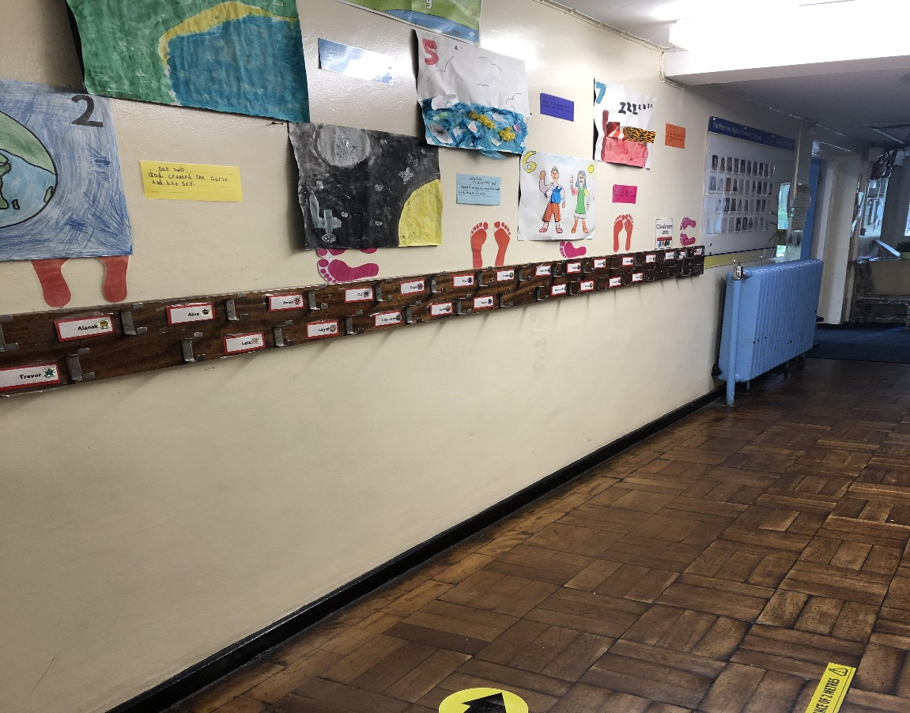
This is where you will hang your coat and bag.

Slide 6
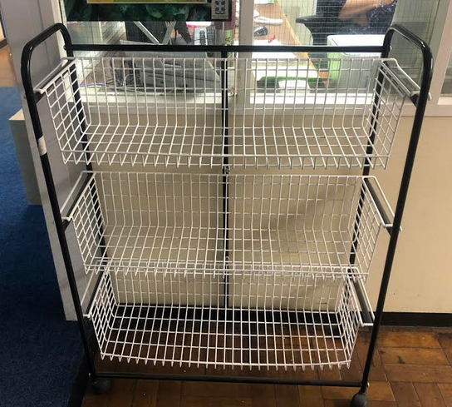
^{This is where your} water bottle and packed lunches will go.

Slide 7
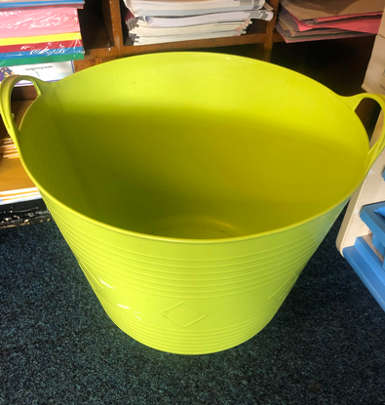
^{This is where your} ^{book bags will go.}

Slide 8
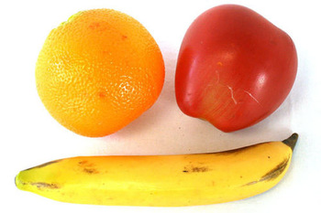
In the morning, we have a snack like this…

Slide 9
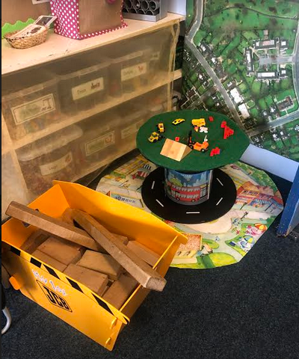
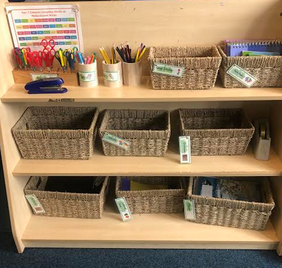
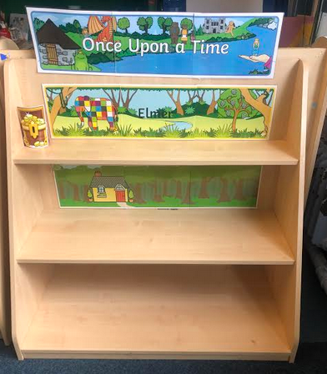
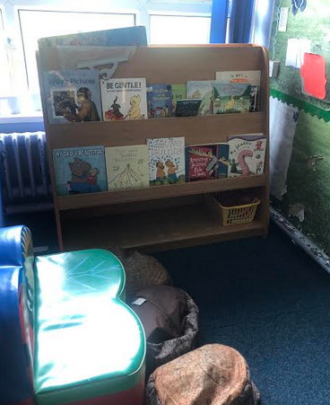
^{We} have lots of things to do and play with in Poppy Class…

Slide 10
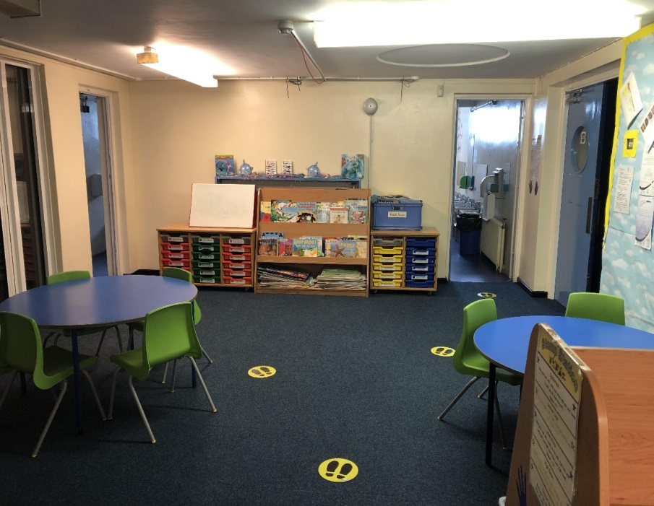
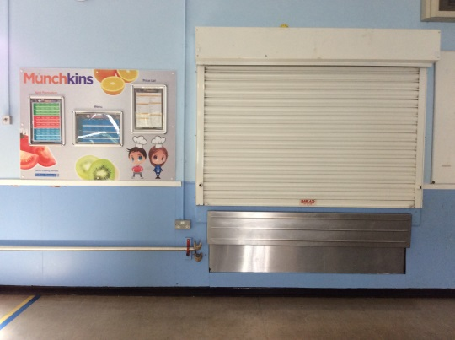
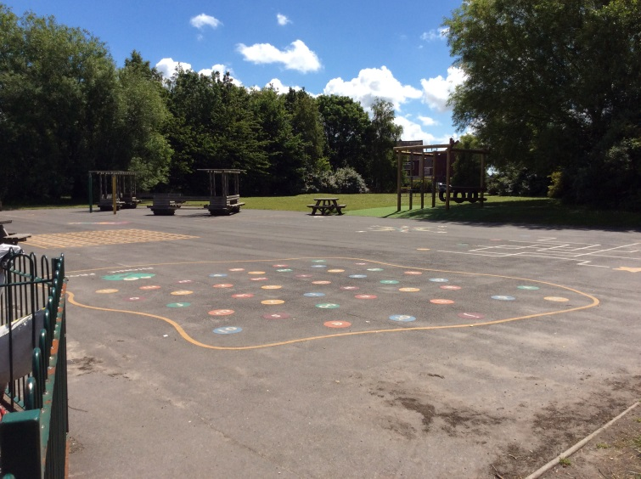
^{Somethings} ^{will stay the same.}

Slide 11
At home time we wait here for someone to collect us, and say goodbye with a big smile!

Slide 12
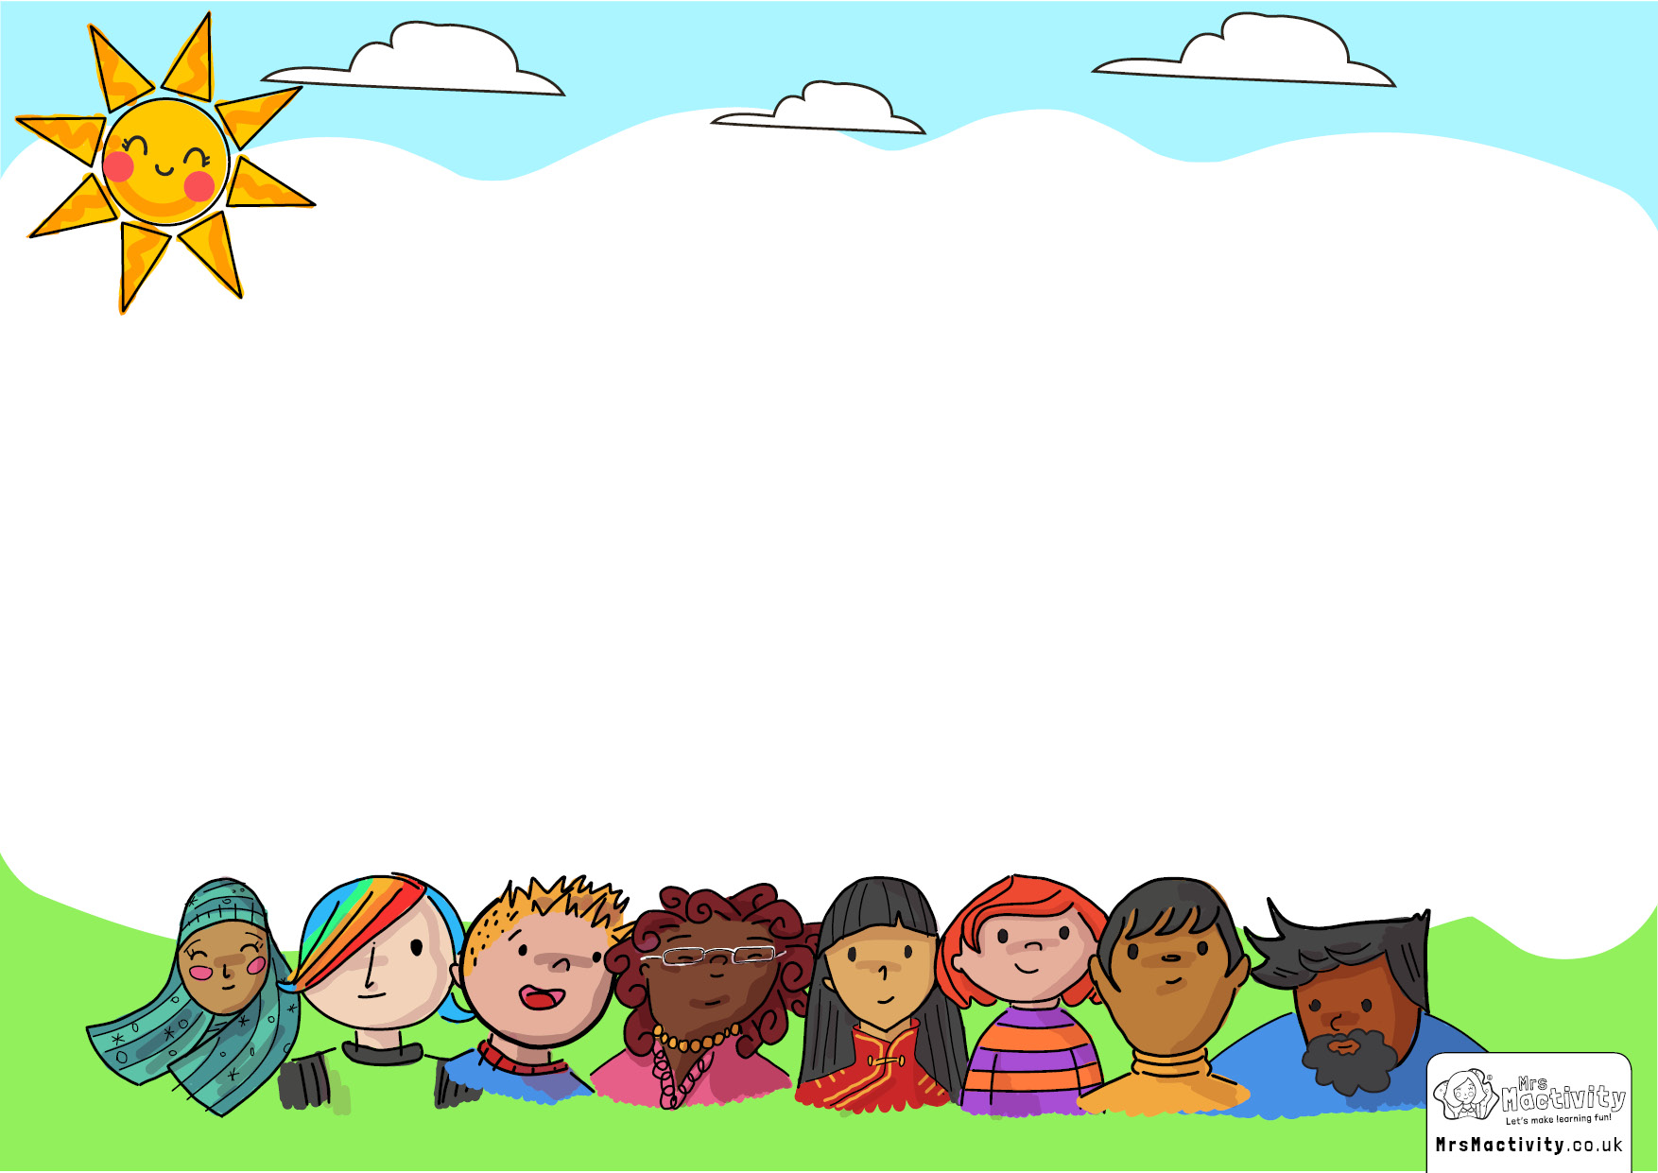
You might feel a bit worried about starting your new class but that’s ok.
There are lots of people who will look after you, and you’ll see all your friends again too!

