Slide 1

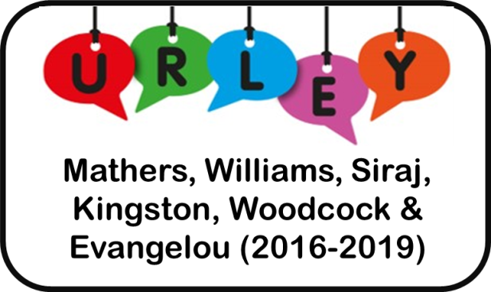
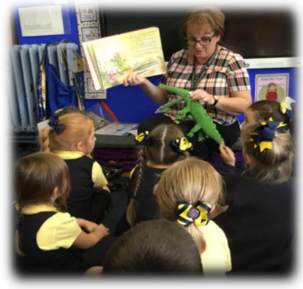
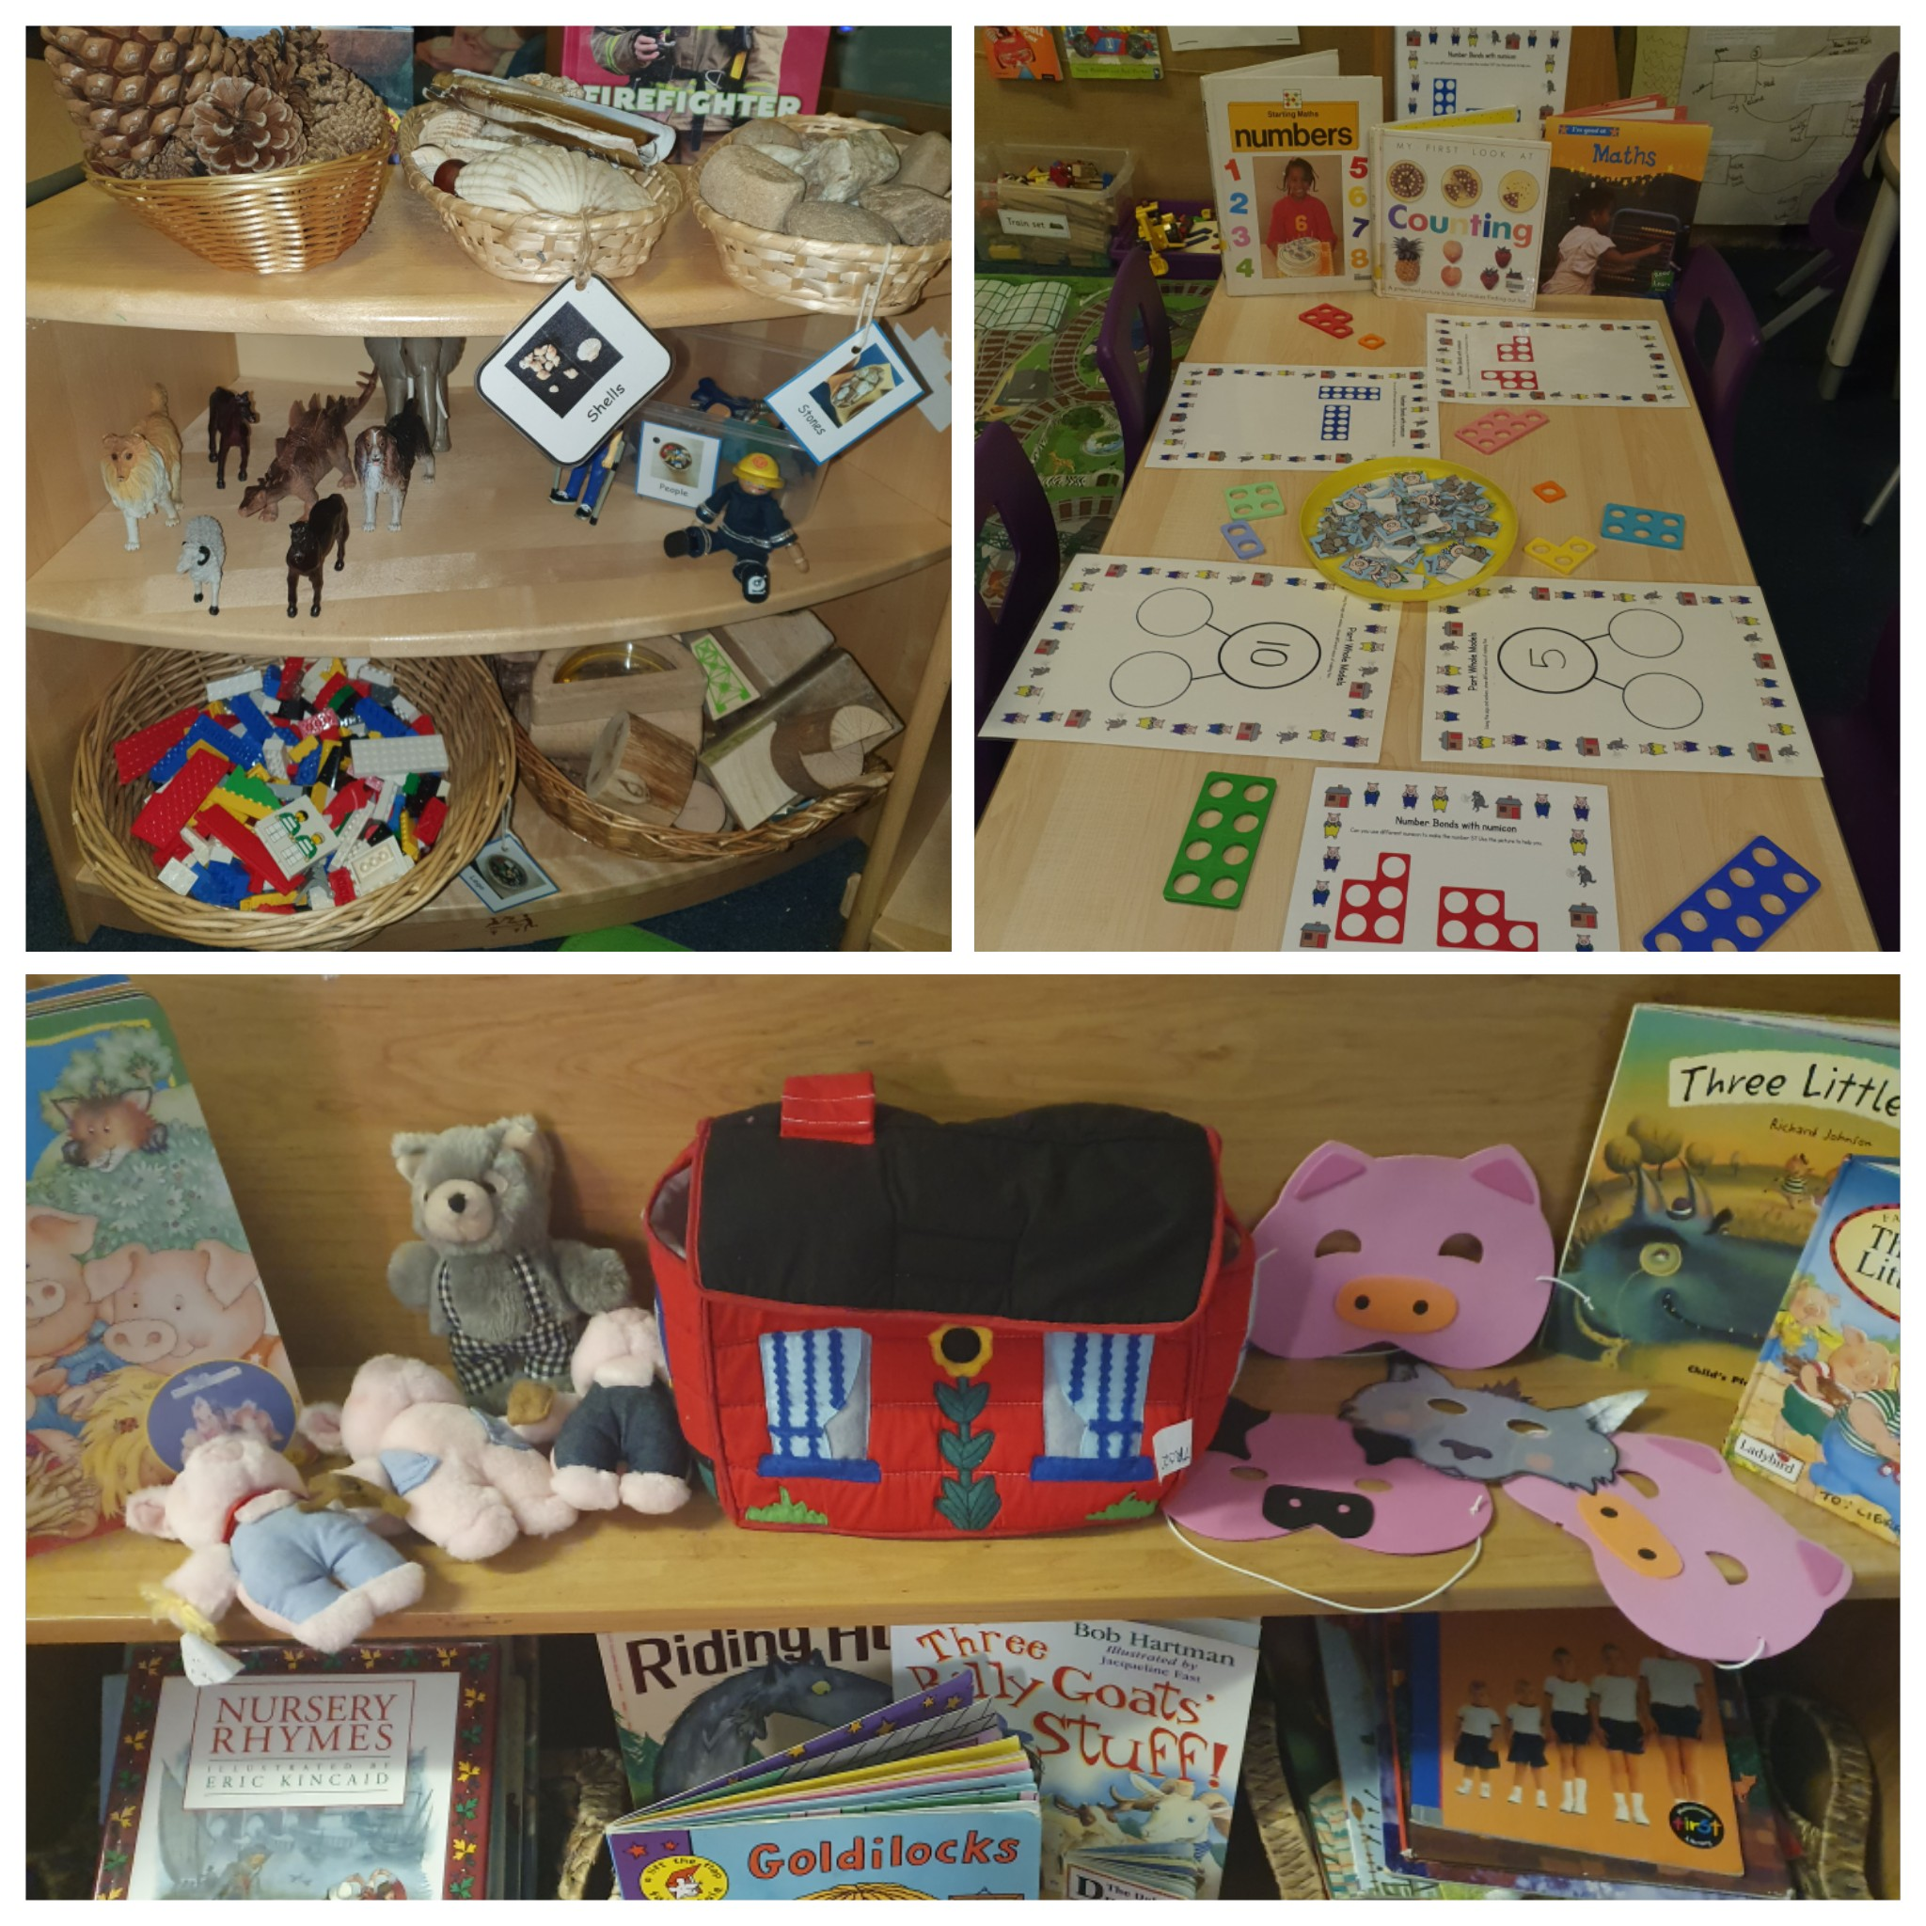
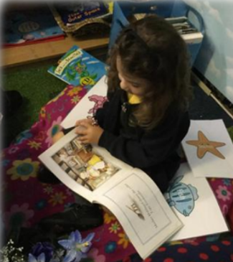



Netherton Moss Language Leaders
Debbie Rainford (Reception Teacher), Jody Benham (Reception Teacher) and Michelle Jones (Nursery Teacher)
c
Enabling Environments
A Language Rich Day at Netherton Moss
Positive Changes
As part of the URLEY project we undertook an audit of our classroom environment using the ECERS-3 auditing tool. The outcome of the audit encouraged our team to make positive changes for example we introduced meaningful and irresistible resources to our construction area, dedicated a shelf in our reading area to a high quality text which includes concrete props, a variety of texts based on the theme and soft furnishings and included language rich texts in all areas.
After extensive research and participation in the URLEY programme, our children’s language skills and personal, social and emotional development has greatly improved. We now have a deeper understanding of how children learn new language and we have become increasingly reflective practitioners with a renewed commitment towards narrowing the vocabulary gap. We have worked hard to designate time to cascade strategies to all staff to further develop children’s language and social communication and narrative skills. Staff at Netherton Moss are language radiators and magnets for communication.
Our Unique Children
As teachers our role is to create a language rich environment and to provide opportunities for our children to communicate. At Netherton Moss we embed URLEY principles into everyday practice. All children engage in dialogue with adults about a wide range of subjects that both conversationalists are interested in. Daily shared reading in small groups takes place in order to model skills of proficient readers, provide rich language and opportunities for talk and discussion. We provide resources of interest for children to play and explore with. Our children learn through free play and guided play with adults playing an important role in sensitively scaffolding language. We are intentional teachers that make use of every opportunity throughout the day.
We are aware that all children develop at different rates therefore it was vital that we were aware of each child’s initial oral language skills. An initial assessment took place using a rating scale called TROLL. This allowed us to inform our teaching and next steps in relation to their social narrative, syntax and morphology and reading. We also assessed the children’s conversational styles using the Hanen Centre assessment tool. This enabled us to understand their ability to begin interactions with others and how they respond when others start an interaction. Once the assessment was completed we planned for extended quality interactions. When the children were re-assessed at the end of the project the outcomes were staggering. Every child had made progress and were more effective social communicators.
Not only did we assess our children but we evaluated our own teaching and practice alongside URLEY mentors using ECERS-3 and SSTEW. We were able to set targets and make changes to our teaching and environment in order to ensure that our children get the very best start at Netherton Moss.
Netherton Moss – The School that Sparkles.
Parental Involvement
Our children’s home environment and the adults within them are the most significant influence on their language development. We have worked hard to engage and support parents and carers, to embed the URLEY approach. So far we have invited parents to attend reading workshops in order to develop their understanding of how books provide a powerful context for conversation with their children and allow them to gain new vocabulary. We have also encouraged parents to support their children with homework for example asking them to assist their children in creating ‘chatter bags’. The children showed great motivation to talk about their interests and experiences.
Language Leaders: a SSIF
Project funded by the DfE

